Slide 1

What is time?
Henrik Feldt 2012-11-01

Slide 2
Me
Henrik Feldt
@henrikfeldt
https://github.com/haf

Slide 3
This presentation
Mostly about the fourth dimension:
Introduction
Time Zones
Daylight Savings
Leaping Things, NTP
Unix Epoch
About NUMA & Multi-Core
Travelling With Time
There Is No Time
Questions!
Questions?

Slide 4
So what’s time?
Naïve: ”Something that goes ’tick’”

Slide 5
Tick

Slide 6
TACK

Slide 7
Tick

Slide 8
So what’s time?
Better: ”A stream of ticks”

Slide 9
Series of ticks
T1
T2
T3
T4
...
TIME

Slide 10
Using induction;
Time is monotonically increasing

Slide 11


All around the world
T = Tick, tack, tick...
T = Tick, tack, tick...
T = Tick, tack, tick...
T = Tick, tack, tick...

Slide 12
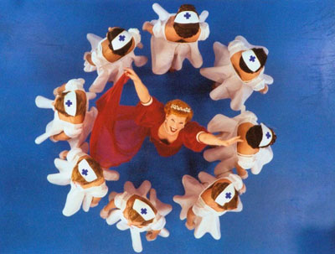
Solution! One global time and date!
long time = 42;
Schedule.Every(1.Ticks(), () => {time++;})
Notes:
We’ll have a counter, called time, and we increment it every tick!
Now we have time!

Slide 13

That’s it?

Slide 14
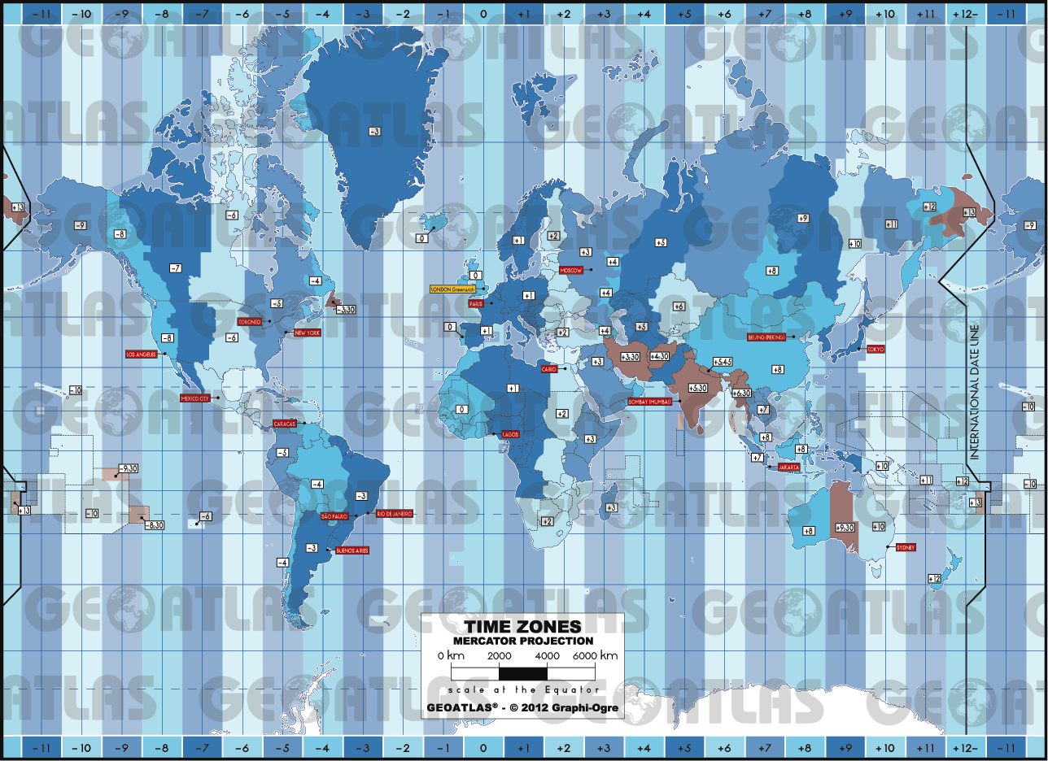
Time Zones

Slide 15
24 of them
There’s a database about them called the ’Olsen database’!
Microsoft has its own world view in the system registry:
DateTime.Now is in local time zone according to this registry.
Notes:
The tz database, also called the zoneinfo database or IANA Time Zone Database, is a collaborative compilation of information about the world's time zones, primarily intended for use with computer programs and operating systems.^{[1]} It is sometimes referred to as the Olson database after the founding contributor Arthur David Olson.^{[2]} Paul Eggert is editor and maintainer of the tz database.^{[3]}

Slide 16
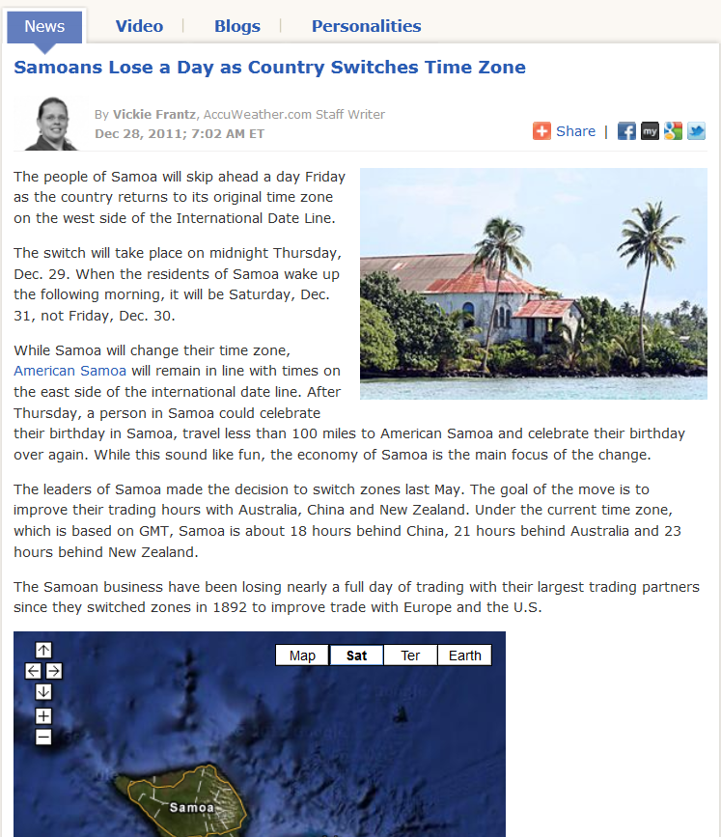
Hey, governments decide those!

Slide 17
Cultures and DateTime
Depends on: Thread.Current.CurrentCulture
Culture? Like a country state w/ shared common values such as the football-team or ethics philosophy?
-> Depends on: Time Zone

Slide 18
What about this?
Assume clock doesn’t tick between these statements:
DateTime utc = DateTime.UtcNow; DateTime local = DateTime.Now; bool mystery = local == utc;
What is mystery?
Notes:
It should always be true: the two values are associated with the same instant in time, it's just that one is expressed locally and one is expressed universally
It should always be false: the two values represent different kinds of data, so are automatically unequal.
It should return true if your local time zone is currently in sync with UTC, i.e. when time zones are disregarded completely, the two values are equal

Slide 19
Mystery is

Slide 20
Mystery is
Still a mystery! Undecidable.
Notes:
We cannot know anything about that variable!

Slide 21
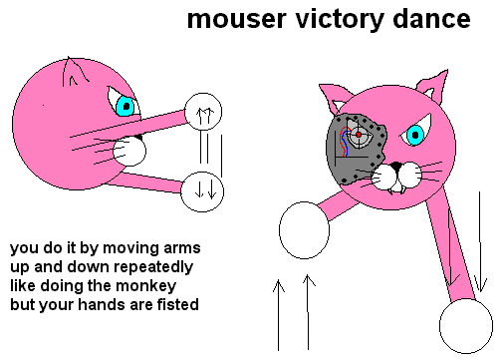
Solution!
We’ll make really really sure we keep the time zone database up to date!
Notes:
http://mecha-catbot.com/MousrPgs/mousrFan.htm

Slide 22
That’s it?

Slide 23
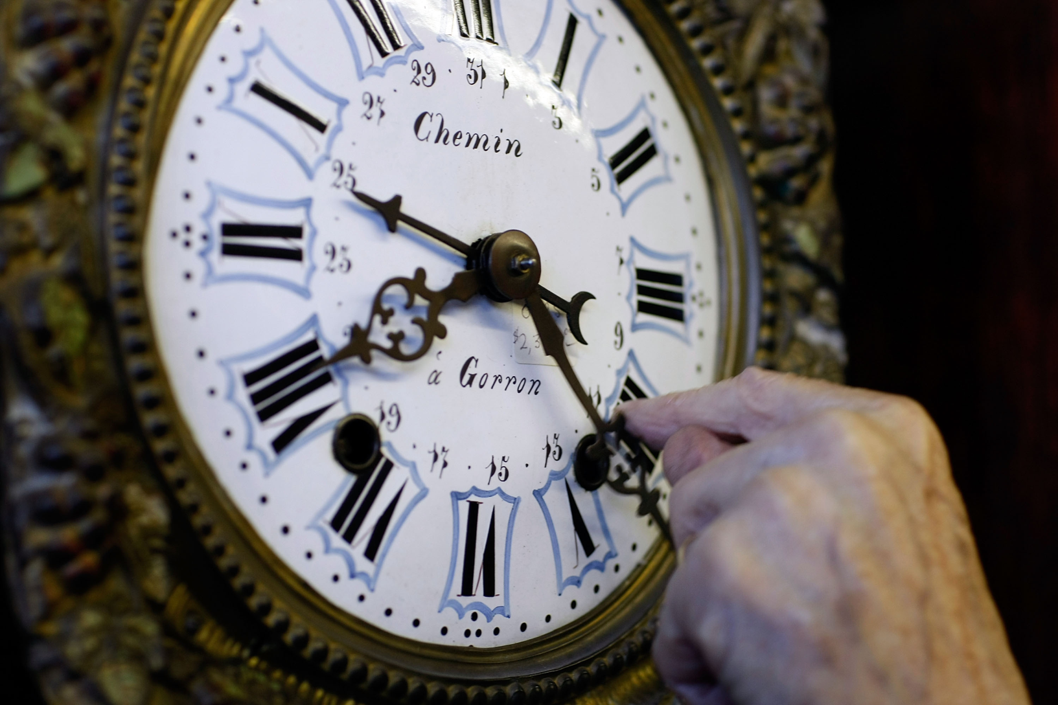
Daylight Savings
Notes:
We manually turn back the clock forward by an hour at the start of spring and then back at fall.
http://www.answers.com/topic/daylight-savings-time-large-image

Slide 24
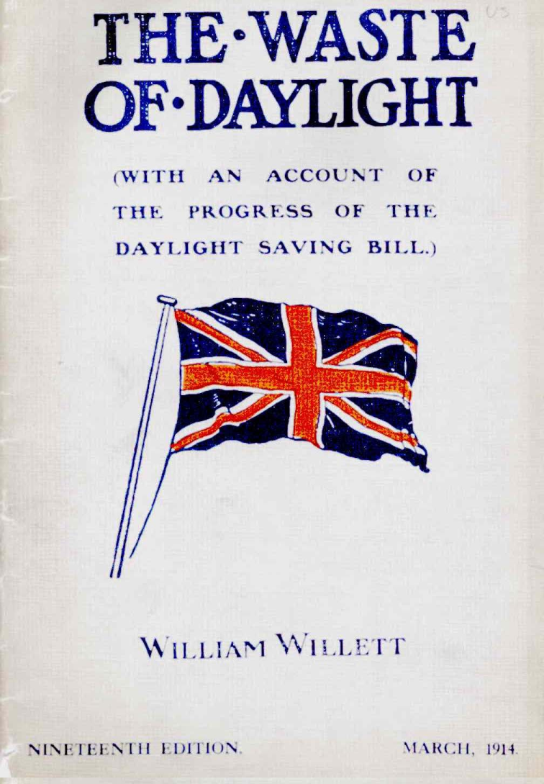
Great! More Daylight!

Slide 25
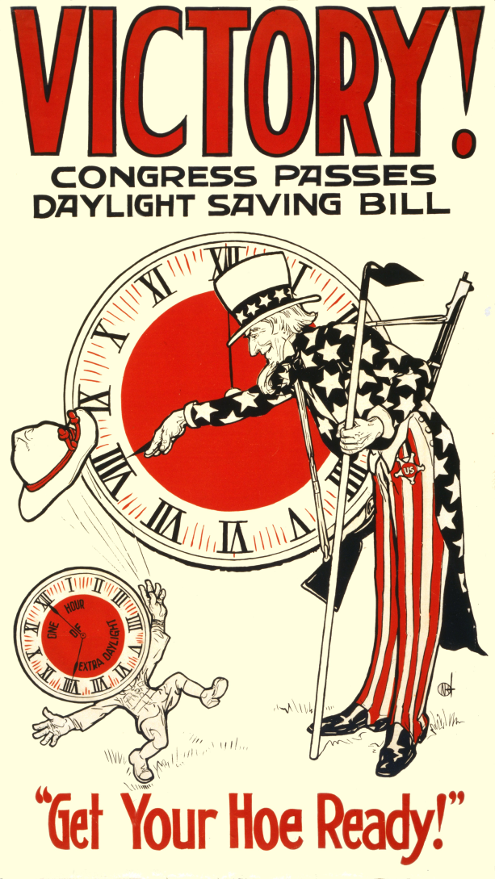
Great! More Daylight!

Slide 26
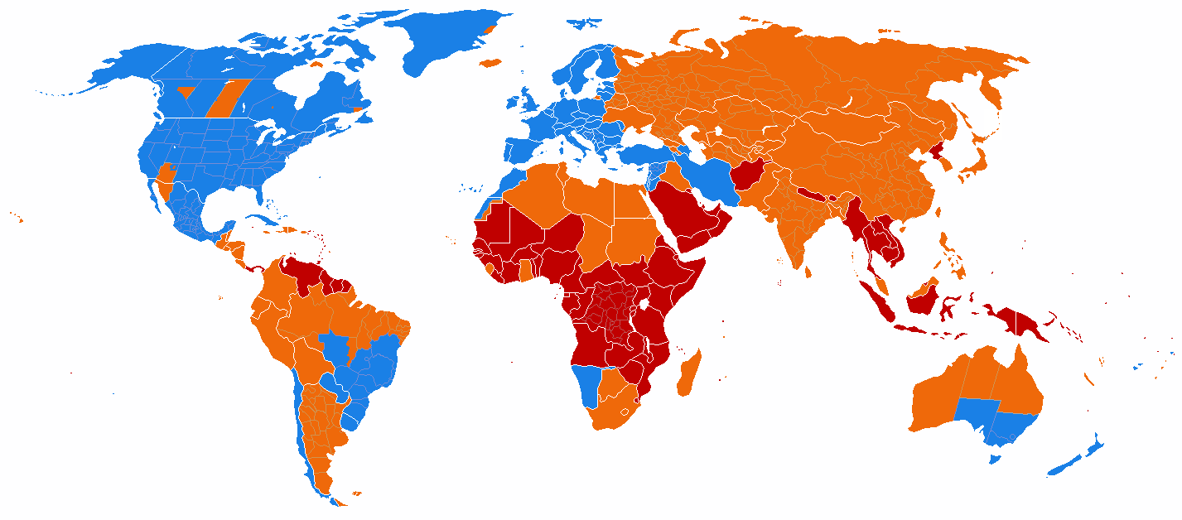
Daylight Savings – All Around the World
Notes:
What???
blue = DST observed
orange = DST no longer observed
red = DST never observed
Turns out it has only been in place since the first world war, implemented by a guy called George Vernon Huson and it’s mostly the western world that does it.
http://en.wikipedia.org/wiki/Daylight_savings

Slide 27
No Consensus!

Slide 28
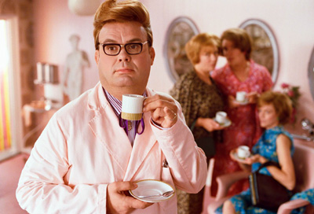
A solution!
DateTime.UtcNow
Coordinated Universal Time!

Slide 29
That’s it?

Slide 30
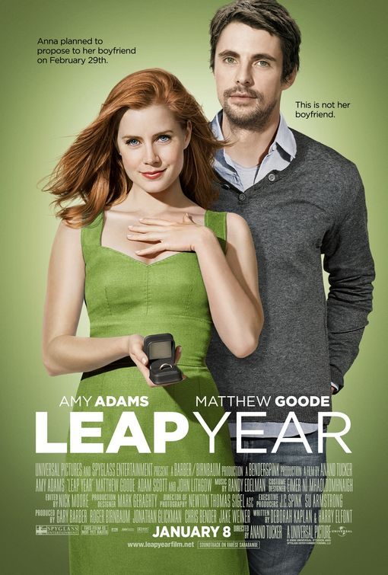
Leap Years
Notes:
There’s something called leap years!
http://www.impawards.com/2010/leap_year.html

Slide 31
Leap Years
Every forth year (year % 4 = 0)
Never the hundredth year (year % 100 = 0)
Every four hundredth year (year % 400 = 0)
leap_year = forth && (!hundredth || fourhundredth)

Slide 32
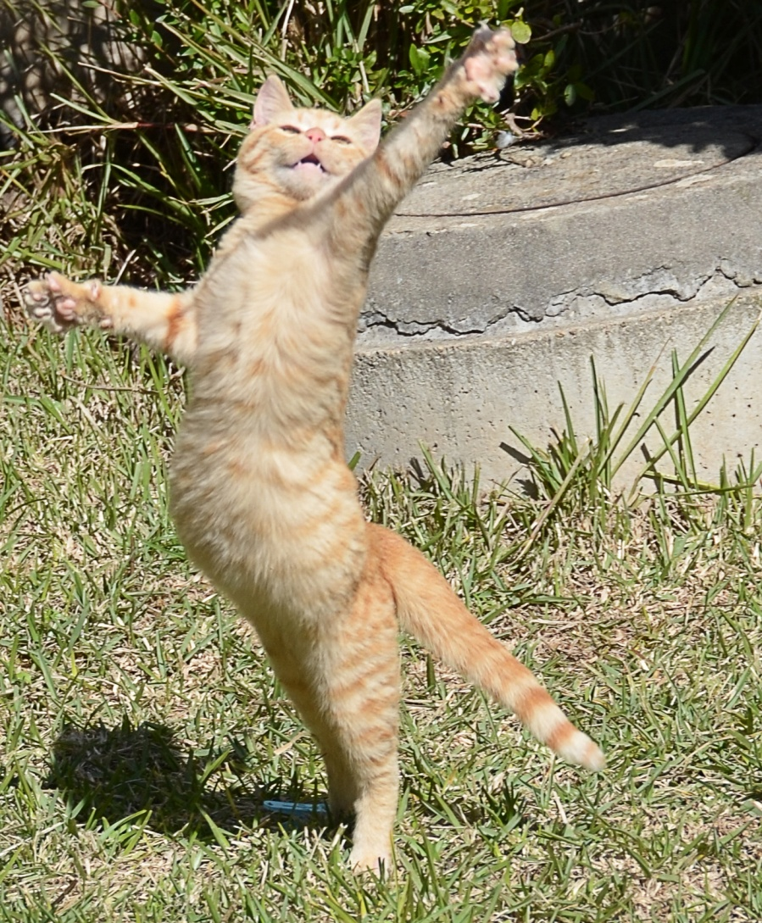
Solution!
We’ll keep a database and a lib!
Notes:
We’ll push that into a library and be done with it!

Slide 33
That’s it?

Slide 34

Leap Seconds
Notes:
It turns out that time goes backwards sometimes by convention to keep up with the earth’s movement around the sun!
Usually handled by either not performing clock ticks for the duration of a second or by speeding them up.

Slide 35
Leap Seconds
A leap second is a positive or negative one-second adjustment to the Coordinated Universal Time (UTC) time scale that keeps it close to mean solar time.
Notes:
It turns out that time goes backwards sometimes by convention to keep up with the earth’s movement around the sun!
Usually handled by either not performing clock ticks for the duration of a second or by speeding them up.

Slide 36

What would that look like?
var start = DateTime.Now;
var heartbeat = DateTime.Now; // president alive
var is_dead = heartbeat - start > 1.Seconds()
if (is_dead)
fire_lé_missiles!!!();

Slide 37
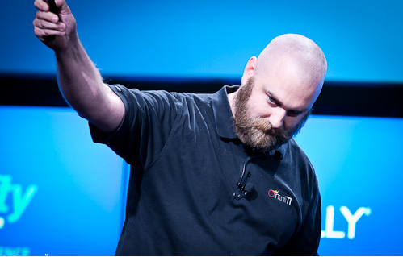
Theo Schlossnagle
”Anyone using DateTime in a program to compare on have at least one bug”
Notes:
Paraphrasing Theo

Slide 38
That’s it?

Slide 39

Time Representation Problems
Notes:
Computers are finite in storage, storing ones and zeroes.

Slide 40
Finite Discrete Memory
n bits in multiples of 32
need to decide on ’accurate enough’ time

Slide 41
Two Approaches
Ticks
Unix Epoch
Every 100 microsecond
Signed Integer
Increments Every Second

Slide 42
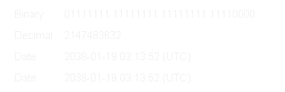
The Year 2038 Problem

Slide 43
That’s it?

Slide 44
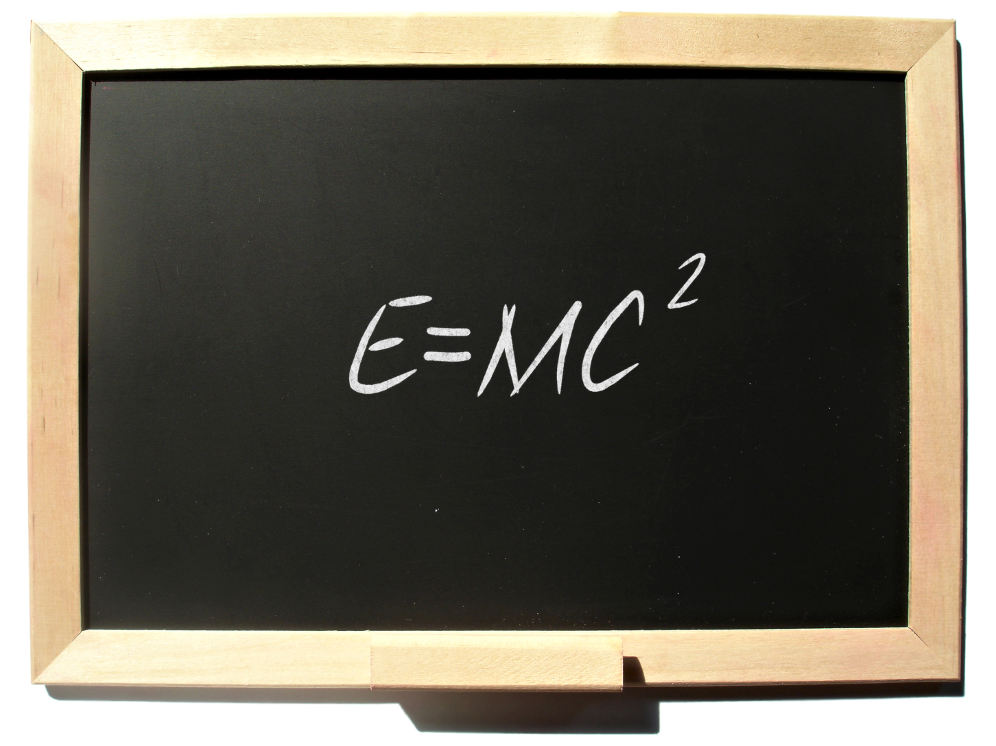
Einstein – Speed of Light
Notes:
Energy [J] = rest mass * c^2
c = 3*10^8 [m/s]

Slide 45
Electrons have rest mass!! ...i.e.
Ping > 0.0000000 ms
because electrons travel around 0.9 c

Slide 46
All around the world
Here we are!
T = 0 s
Earth circumference = 40008 km
Info here at T = (40008/12) / 0.9c = 0+ 1.23 * 10⁻⁵ s
T = 0 + 2.46 * 10⁻⁵ s
T = 0 + 3.69 * 10⁻⁵ s
Notes:
At .9c it takes some time before the information reaches other locations.
Even at c it would take time, because c != infinity.

Slide 47
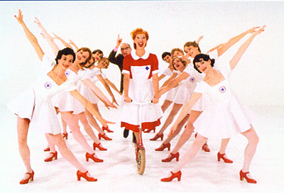
Easy! Just account for .9c!
DateTime.UtcNow + distance / .9c = time at arrival!
We’ll create a time library that has that logic!

Slide 48
That’s it?

Slide 49
Einstein – Relativity
Notes:
Energy [J] = rest mass * c^2
c = 3*10^8 [m/s]

Slide 50
There is no global time!

Slide 51
Questions!
When _do_ we use DateTime.Now?
When is it appropriate to use another date library?
What library?
How would you represent an instant on the time line?
Notes:
(break into component parts?)

Slide 52
Questions!
What if there’s more than a single CPU?
What if we’re in a cluster?
What if the client’s clock is off?
Notes:
(break into component parts?)

Slide 53
Questions?

Slide 54
Tack för mig!

